Slide 1
Digital Image Processing
Lecture # 2
Connected Component Analysis

Slide 2
Relationships between pixels
Neighbors of pixel are the pixels that are adjacent pixels of an identified pixel
y-1
y
y+1
x-1
x
x+1
2
Notes:
2

Slide 3

4- Neighbors of a Pixel –N₄(p)
y-1
y
y+1
x-1
What are the coordinates of each of the blue pixels
x
x+1
(x-1,y), (x+1,y), (x, y-1), (x, y+1)
3
Notes:
3

Slide 4
Diagonal Neighbors of a Pixel –N_{D}(p)
y-1
y
y+1
x-1
x
x+1
(x-1,y-1), (x+1,y-1), (x-1, y+1), (x+1, y+1)
4
Notes:
4

Slide 5
8- Neighbors of a Pixel –N₈(p)
y-1
y
y+1
x-1
x
x-1
(x-1,y), (x+1,y), (x, y-1), (x, y+1)
(x-1,y-1), (x+1,y-1), (x-1, y+1), (x+1, y+1)
5
Notes:
5

Slide 6
Connectivity
Establishing boundaries of objects and components in an image
Group the same region by assumption that the pixels being the same color or equal intensity
Two pixels p & q are connected if
  They are adjacent in some sense
  If their gray levels satisfy a specified criterion of similarity
6
Notes:
6

Slide 7
Connectivity
V: Set of gray levels used to define the criterion of similarity
4-connectivity
If gray level
Set of gray levels V = {1}
7
Notes:
7

Slide 8
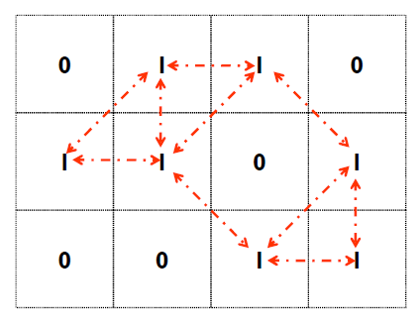
Connectivity
V: Set of gray levels used to define the criterion of similarity
8-connectivity
If gray level
Set of gray levels V = {1}
8
Notes:
8

Slide 9
Connectivity
V: Set of gray levels used to define the criterion of similarity
m-connectivity (Mixed Connectivity)
If gray level
a.
b.
9
Notes:
9

Slide 10
Example: m – Connectivity
Set of gray levels V = {1}
Note: Mixed connectivity can eliminate the multiple path connections that often occurs in 8-connectivity
10
Notes:
10

Slide 11
Paths
Path: Let coordinates of pixel p: (x, y), and of pixel q: (s, t)
A path from p to q is a sequence of distinct pixels with coordinates: (x₀, y₀), (x₁, y₁), ......, (x_{n},y_{n})
where (x₀, y₀) = (x, y) & (x_{n},y_{n}) = (s, t), and (x_{i},y_{i}) is adjacent to (x_{i-1},y_{i-1}) 1≤i ≤n
11
Notes:
11

Slide 12
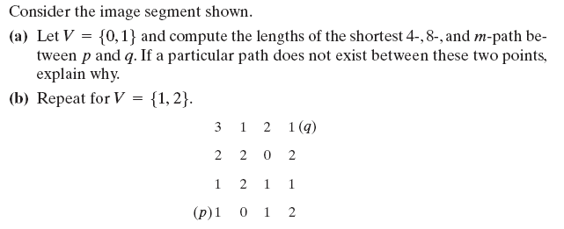
Test Yourself

Slide 13
Determine different regions in the image
13
Notes:
13

Slide 14
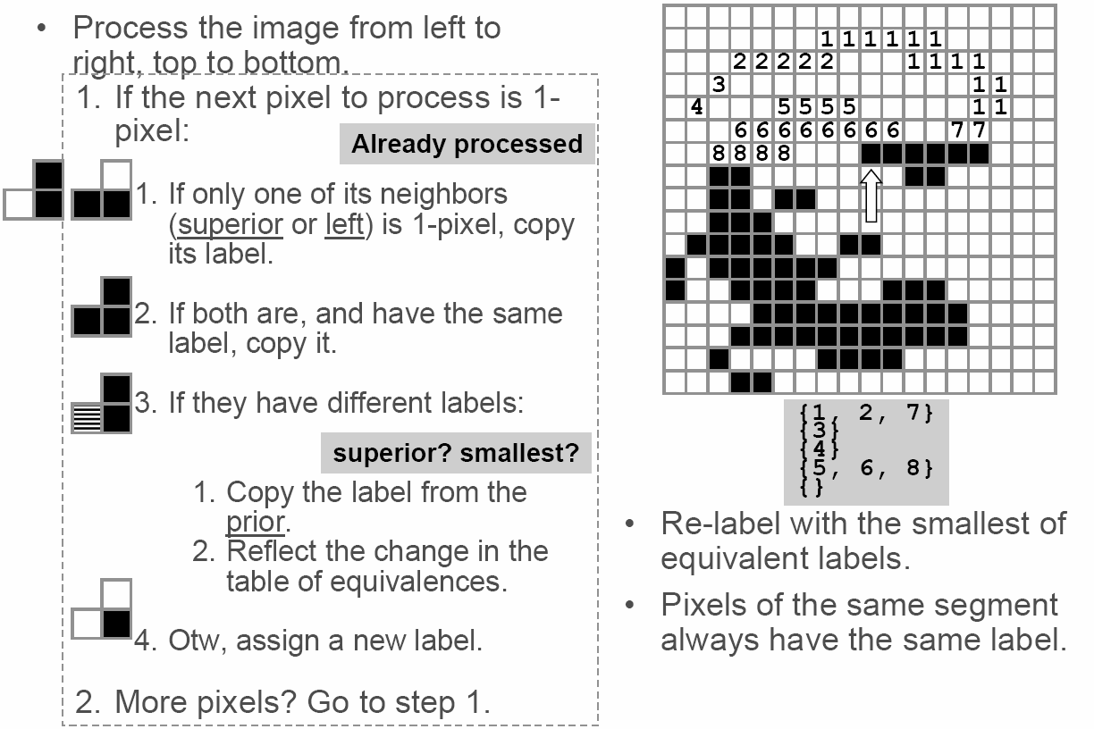
CC labeling – 4 Connectivity
Process the image from left to
right, top to bottom:
  1.) If the next pixel to process is 1
  i.) If only one of its neighbors
  (top or left) is 1, copy its label.
  ii.) If both are 1 and have the
  same label, copy it.
  iii.) If they have different labels
  − Copy the label from the left.
  − Update the equivalence table.
  iv.) Otherwise, assign a new label.
Re-label with the smallest of equivalent
labels
Pass 1
Pass 2
14
Notes:
14

Slide 15

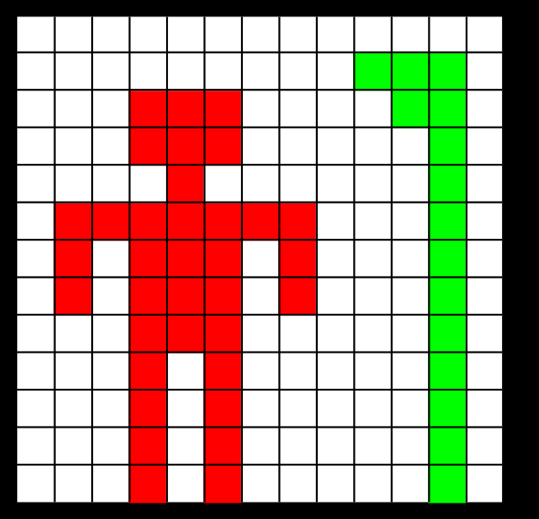
CC labeling – 4 Connectivity
15
Notes:
15

Slide 16

CC labeling – 4 Connectivity
16
Notes:
16

Slide 17
CC labeling – 8 Connectivity
Same algorithm but examine also the upper diagonal neighbors of p
17
Notes:
17

Slide 18
CC labeling – 8 Connectivity
Background pixel
Background pixel
Unlabeled Pixel
Unlabeled Pixel
Label 1
18
Notes:
18

Slide 19
CC labeling – 8 Connectivity
Background pixel
Background pixel
Unlabeled Pixel
Unlabeled Pixel
Label 1
Label 1
Label 2
Label 2
Label 3
19
Notes:
19

Slide 20
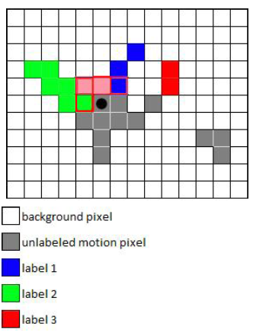
CC labeling – 8 Connectivity
Background pixel
Background pixel
Unlabeled Pixel
Unlabeled Pixel
Label 1
Label 1
Label 2
Label 2
Label 3
Label 3
20
Notes:
20

Slide 21
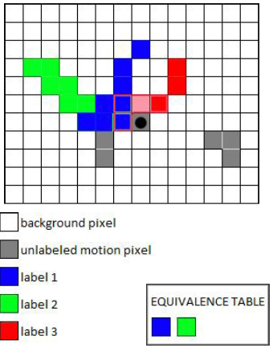
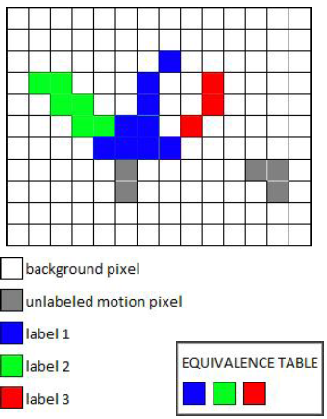
CC labeling – 8 Connectivity
Background pixel
Background pixel
Unlabeled pixel
Unlabeled pixel
Label 1
Label 1
Label 2
Label 2
Label 3
Label 3
21
Notes:
21

Slide 22
CC labeling – 8 Connectivity
Background pixel
Background pixel
Unlabeled pixel
Unlabeled pixel
Label 1
Label 1
Label 2
Label 2
Label 3
Label 3
Label 4
Label 4
22
Notes:
22

Slide 23
Distance Metrics
Let pixels p, q and z have coordinates (x,y), (s,t) and (u,v) respectively.
D is a distance function or metric if
  D(p,q) ≥ 0 and
  D(p,q) = 0 iff p = q and
  D(p,q) = D(q,p) and
  D(p,z) ≤ D(p,q) + D(q,z)
23
Notes:
23

Slide 24
City block distance (D₄ distance)
Diamond with center at (x,y)
D₄ = 1 are the 4 neighbors of pixel p(x,y)
24
Notes:
24

Slide 25
Chessboard distance (D₈ distance)
Square centered at p(x,y)
D₈ = 1 are the 8 neighbors of pixel p(x,y)
25
Notes:
25

Slide 26
Euclidean Distance
A circle with radius r centered at (x,y)
q(s,t)
r
p(x,y)
26
Notes:
26

Slide 27
Arithmetic Operations
Carried out between corresponding pixel pairs
27
Notes:
27

Slide 28
Arithmetic Operations
Conversion to range 0 – 255
Difference of two 8-bit images: -255 to 255
Sum of two 8-bit images: 0 to 510
Solution?
Set all values < 0 to 0
Set all values > 255 to 255
Full range of arithmetic operation not captured
28
Notes:
28

Slide 29
Arithmetic Operations
First perform the operation
Then perform
Creates an image whose minimum value is 0
Creates a scaled image f_{s} with values in the range [0 K]
29
Notes:
29

